Slide 1
Unit #3: Strand #4: Catholic Doctrine

Slide 2
I. Precepts of the Catholic Church
The Precepts of the Catholic Church are a description of the absolute minimum actions required of Catholics regarding the Church.
The Church uses these precepts remind us that Christian life requires a commitment to prayer and active participation in the liturgy and sacraments.
If we fall below this bare-minimum level, we can’t rightly consider ourselves to be in full communion with the Catholic Church.
Each of these precepts of the Catholic Church is a requirement. Together with the Ten Commandments, they represent the minimum level of moral living.
Intentional violation of the precepts or the Commandments is a grave matter, meaning a mortal sin.

Slide 3
I. Precepts of the Catholic Church
The Precepts – There are 5 Precepts
You shall attend Mass on Sundays and on holy days of obligation and rest from servile labor as well as the principal feast days, known as Catholic holy days of obligation.
You shall confess your sins at least once a year.
You shall receive the sacrament of the Eucharist at least during the Easter season.
You shall observe the days of fasting and abstinence established by the Church.
You shall help to provide for the needs of the Church.

Slide 4
II. The Four Marks of the Church
The Marks of the True Church
We know that Our Lord Jesus Christ established a Church before He ascended into Heaven. He made St Peter the head of that Church. But does that Church still exist?
Most true Christians accept as the basis of their faith those truths set forth in the Nicene Creed. It is in that Creed that we learn the true marks (or indicia) of the True Church of Christ.
The Marks of the True Church – The way that we are able to identify the True Church of Jesus Christ is through the Marks or Indicia (indicators) Jesus left on her to help us identify her.

Slide 5
II. The Four Marks of the Church
The Marks of the True Church – There are Four Marks of the Church
That the Church is:
ONE,
HOLY,
CATHOLIC and
APOSTOLIC.

Slide 6
II. The Four Marks of the Church
The Church is
ONE,
There is only one Christian Church, united in faith, in worship and in in succession from the Apostles themselves. For the Church is the Body of Christ Himself, and so is whole and one as Christ’s Body is whole and one.

Slide 7
II. The Four Marks of the Church
The Church is
HOLY,
The Church … as a matter of faith, is unfailingly holy.
This is because Christ, the Son of God, who with the Father and the Spirit is hailed as “alone holy”, loved the Church as His Bride, giving Himself up for her so as to sanctify her; He joined her to Himself as his body and endowed her with the gift of the Holy Spirit for the glory of God."

Slide 8
II. The Four Marks of the Church
The Church is
Catholic,
“Catholic” in this sense is the “small-c” “catholic”, which means “universal”.
The Church can be found in St Peter’s Basilica, in a suburban parish church, in a group of faithful in the Amazon Jungle. But being one in faith and communion with the Church in Rome makes this Church a universal collection of those “particular Churches”.
Particular Churches fall to the care of Bishops, the pastors of the faithful and successors of the Apostles. Their communion with each other and with the Bishop of Rome makes the Catholic Church truly universal.

Slide 9
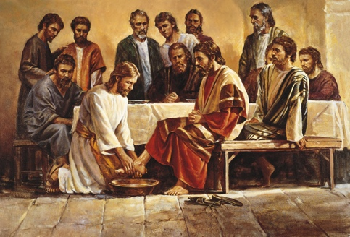
II. The Four Marks of the Church
The Church is
Apostolic
The Catholic Church validly claims succession from the Apostles themselves.
All bishops of the Catholic Church are ordained by bishops who themselves were ordained by bishops who themselves were ordained … and so on … who themselves were ordained by the Apostles.
Other Churches, no longer in communion with the Church of Rome, have also maintained Apostolic Succession. The Orthodox Churches, certain of the bishops of the Anglican Communion and the bishops of the Society of St Pius X.

Slide 10
II. The Four Marks of the Church
This is the sole Church of Christ,
which in the Creed we profess to be one, holy, catholic and apostolic."
These four characteristics, inseparably linked with each other,
indicate essential features of the Church and her mission.
The Church does not possess them of herself; it is Christ who, through the Holy Spirit, makes his Church one, holy, catholic, and apostolic, and it is he who calls her to realize each of these qualities. (CCC 811).

Slide 11
III. The Hierarchy of the Catholic Church
Laity

Slide 12
III. The Hierarchy of the Catholic Church
The Episcopal College and its head, the Pope
When Christ instituted the Twelve Apostles, "He constituted them in the form of a college or permanent assembly, at the head of which he placed Peter, chosen from among them."
Just as "by the Lord's institution, St. Peter and the rest of the apostles constitute a single apostolic college, so in like fashion the Roman Pontiff, Peter's successor, and the bishops, the successors of the apostles, are related with and united to one another.”

Slide 13
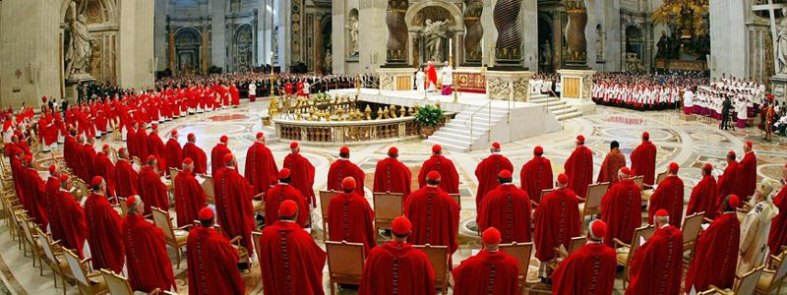
III. The Hierarchy of the Catholic Church
The Episcopal College and its head, the Pope
When Christ instituted the Twelve Apostles, He constituted them in the form of a college or permanent assembly…
Just as by the Lord's institution, St. Peter and the rest of the apostles constitute a single apostolic college, so in like fashion the Roman Pontiff, Peter's successor, and the bishops, the successors of the apostles, are related with and united to one another.

Slide 14
III. The Hierarchy of the Catholic Church
The Episcopal College and its head, the Pope
When Christ instituted the Twelve Apostles, He constituted them in the form of a college or permanent assembly, at the head of which He placed Peter, chosen from among them."
Just as by the Lord's institution, St. Peter and the rest of the apostles constitute a single apostolic college, so in like fashion the Roman Pontiff, Peter's successor, and the bishops, the successors of the apostles, are related with and united to one another.

Slide 15
III. The Hierarchy of the Catholic Church
The Episcopal College and its head, the Pope
The Lord made Simon alone, whom he named Peter, the "rock" of his Church.
He gave him the keys of his Church and
instituted him shepherd of the whole flock.
"The office of binding and loosing which was given to Peter was also assigned to the college of apostles united to its head.”
This pastoral office of Peter and the other apostles belongs to the Church's very foundation and is continued by the bishops under the primacy of the Pope.

Slide 16
Matthew 16:13 ff.
Now when Jesus came into the district of Caesare′a Philippi, he asked his disciples, “Who do men say that the Son of man is?”
¹⁴ And they said, “Some say John the Baptist, others say Eli′jah, and others Jeremiah or one of the prophets.”
¹⁵ He said to them, “But who do you say that I am?”
¹⁶ Simon Peter replied, “You are the Christ, the Son of the living God.”
¹⁷ And Jesus answered him, “Blessed are you, Simon Bar-Jona! For flesh and blood has not revealed this to you, but my Father who is in heaven.
¹⁸ And I tell you, you are Peter, and on this rock I will build my church, and the powers of death shall not prevail against it.
¹⁹ I will give you the keys of the kingdom of heaven,and whatever you bind on earth shall be bound in heaven, and whatever you loose on earth shall be loosed in heaven.”

Slide 17
Matthew 16:13 ff.
Now when Jesus came into the district of Caesare′a Philippi, he asked his disciples, “Who do men say that the Son of man is?”

Slide 18
Matthew 16:13 ff.
Now when Jesus came into the district of Caesare′a Philippi, he asked his disciples, “Who do men say that the Son of man is?”
¹⁴ And they said, “Some say John the Baptist, others say Eli′jah, and others Jeremiah or one of the prophets.”

Slide 19
Matthew 16:13 ff.
Now when Jesus came into the district of Caesare′a Philippi, he asked his disciples, “Who do men say that the Son of man is?”
¹⁴ And they said, “Some say John the Baptist, others say Eli′jah, and others Jeremiah or one of the prophets.”
¹⁵ He said to them, “But who do you say that I am?”

Slide 20
Matthew 16:13 ff.
Now when Jesus came into the district of Caesare′a Philippi, he asked his disciples, “Who do men say that the Son of man is?”
¹⁴ And they said, “Some say John the Baptist, others say Eli′jah, and others Jeremiah or one of the prophets.”
¹⁵ He said to them, “But who do you say that I am?”
¹⁶ Simon Peter replied,
“You are the Christ, the Son of the living God.”

Slide 21
Matthew 16:13 ff.
¹⁷ And Jesus answered him,
“Blessed are you, Simon Bar-Jona! For flesh and blood has not revealed this to you, but my Father who is in heaven.
¹⁸ And I tell you, you are Peter, and on this rock I will build my church, and the powers of death shall not prevail against it.
¹⁹ I will give you the keys of the kingdom of heaven, and whatever you bind on earth shall be bound in heaven, and whatever you loose on earth shall be loosed in heaven.”

Slide 22
Matthew 16:13 ff.
¹⁷ And Jesus answered him,
“Blessed are you, Simon Bar-Jona! For flesh and blood has not revealed this to you, but my Father who is in heaven.
¹⁸ And I tell you, you are Peter, and on this rock I will build my church, and the powers of death shall not prevail against it.

Slide 23
Matthew 16:13 ff.
“Blessed are you, Simon Bar-Jona! For flesh and blood has not revealed this to you, but my Father who is in heaven.
And I tell you, you are Peter, and on this rock I will build my church, and the powers of death shall not prevail against it.”
Some would argue that the Greek word used for Peter (rock) is a feminine noun and the next uses for the word rock is masculine.
Therefore the verse should read: “You are a little rock (like a girl rock!), but on the big rock (Jesus) I’m building the church!”

Slide 24
Matthew 16:13 ff.
“Blessed are you, Simon Bar-Jona! For flesh and blood has not revealed this to you, but my Father who is in heaven.
And I tell you, you are Peter, and on this rock I will build my church, and the powers of death shall not prevail against it.”
Some would argue that the Greek word used for Peter (rock) is a feminine noun and the next uses for the word rock is masculine.
Therefore the verse should read: “You are a little rock (like a girl rock!), but on the big rock (Jesus) I’m building the church!”
However, Jesus did not speak to the disciples in Greek. He spoke Aramaic. There is no feminine or masculine word for rock in Aramaic. The Aramaic word for rock is kepha, which is what Jesus called Peter. Matthew 16:18 was: "You are Kepha, and upon this kepha I will build my Church.”

Slide 25
Matthew 16:13 ff.
¹⁷ And Jesus answered him,
“Blessed are you, Simon Bar-Jona! For flesh and blood has not revealed this to you, but my Father who is in heaven.
¹⁸ And I tell you, you are Peter, and on this rock I will build my church, and the powers of death shall not prevail against it.
Matthew 16:18 was:
"You are Kepha, and upon this kepha I will build my Church.”

Slide 26
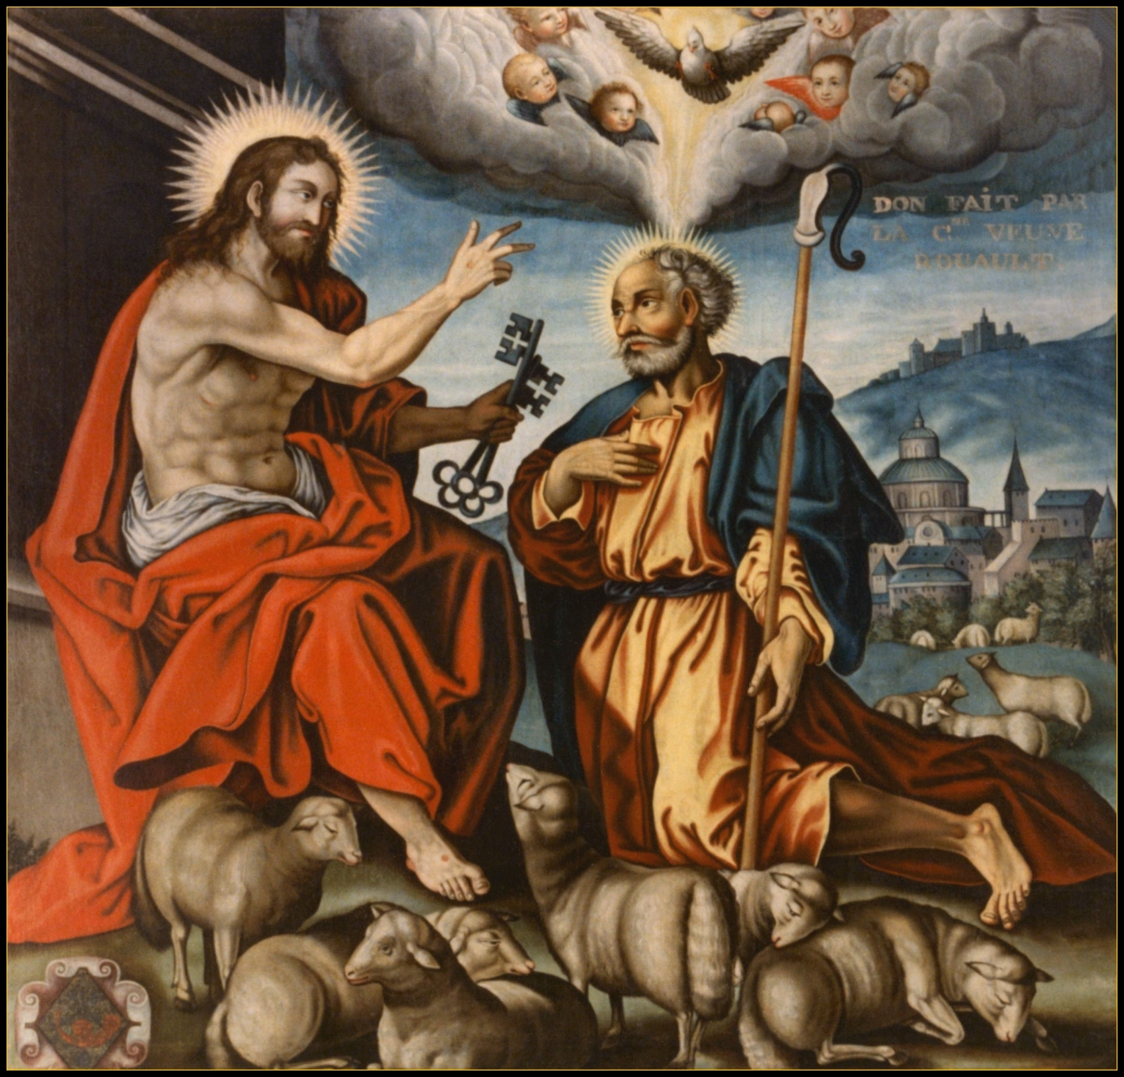
Matthew 16:13 ff.
¹⁷ And Jesus answered him,
“Blessed are you, Simon Bar-Jona! For flesh and blood has not revealed this to you, but my Father who is in heaven.
¹⁸ And I tell you, you are Peter, and on this rock I will build my church, and the powers of death shall not prevail against it.
¹⁹ I will give you the keys of the kingdom of heaven, and whatever you bind on earth shall be bound in heaven, and whatever you loose on earth shall be loosed in heaven.”

Slide 27
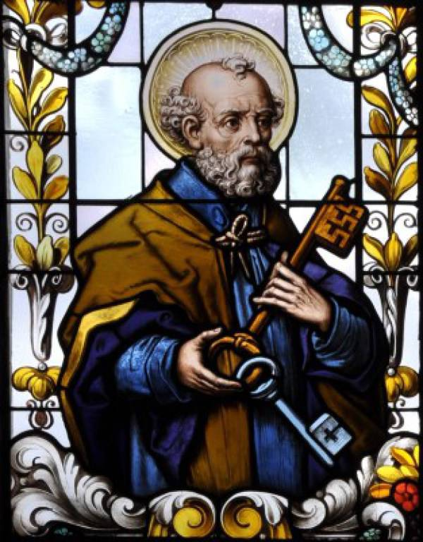
Matthew 16:13 ff.
¹⁷ And Jesus answered him,
“Blessed are you, Simon Bar-Jona! For flesh and blood has not revealed this to you, but my Father who is in heaven.
¹⁸ And I tell you, you are Peter, and on this rock I will build my church, and the powers of death shall not prevail against it.
¹⁹ I will give you the keys of the kingdom of heaven, and whatever you bind on earth shall be bound in heaven, and whatever you loose on earth shall be loosed in heaven.”

Slide 28
Matthew 16:13 ff.
¹⁷ And Jesus answered him,
“Blessed are you, Simon Bar-Jona! For flesh and blood has not revealed this to you, but my Father who is in heaven.
¹⁸ And I tell you, you are Peter, and on this rock I will build my church, and the powers of death shall not prevail against it.
¹⁹ I will give you the keys of the kingdom of heaven, and whatever you bind on earth shall be bound in heaven, and whatever you loose on earth shall be loosed in heaven.”

Slide 29
Matthew 16:13 ff.
¹⁷ And Jesus answered him,
“Blessed are you, Simon Bar-Jona! For flesh and blood has not revealed this to you, but my Father who is in heaven.
¹⁸ And I tell you, you are Peter, and on this rock I will build my church, and the powers of death shall not prevail against it.
¹⁹ I will give you the keys of the kingdom of heaven, and whatever you bind on earth shall be bound in heaven, and whatever you loose on earth shall be loosed in heaven.”

Slide 30
Matthew 16:13 ff.
¹⁷ And Jesus answered him,
“Blessed are you, Simon Bar-Jona! For flesh and blood has not revealed this to you, but my Father who is in heaven.
¹⁸ And I tell you, you are Peter, and on this rock I will build my church, and the powers of death shall not prevail against it.
¹⁹ I will give you the keys of the kingdom of heaven, and whatever you bind on earth shall be bound in heaven, and whatever you loose on earth shall be loosed in heaven.”

Slide 31
Isaiah 22:15-22
¹⁵ Thus says the Lord God of hosts, “Come, go to this steward, to Shebna, who is over the household, and say to him: ¹⁶ What have you to do here and whom have you here, that you have hewn here a tomb for yourself, you who hew a tomb on the height, and carve a habitation for yourself in the rock? ¹⁷ Behold, the Lord will hurl you away violently, O you strong man. He will seize firm hold on you, ¹⁸ and whirl you round and round, and throw you like a ball into a wide land; there you shall die, and there shall be your splendid chariots, you shame of your master’s house. ¹⁹ I will thrust you from your office, and you will be cast down from your station. ²⁰ In that day I will call my servant Eli′akim the son of Hilki′ah, ²¹ and I will clothe him with your robe, and will bind your girdle on him, and will commit your authority to his hand; and he shall be a father to the inhabitants of Jerusalem and to the house of Judah. ²² And I will place on his shoulder the key of the house of David; he shall open, and none shall shut; and he shall shut, and none shall open.

Slide 32
Isaiah 22:15-22
¹⁵ Thus says the Lord God of hosts, “Come, go to this steward, to Shebna, who is over the household, and say to him: ¹⁶ What have you to do here and whom have you here, that you have hewn here a tomb for yourself, you who hew a tomb on the height, and carve a habitation for yourself in the rock? ¹⁷ Behold, the Lord will hurl you away violently, O you strong man. He will seize firm hold on you, ¹⁸ and whirl you round and round, and throw you like a ball into a wide land; there you shall die, and there shall be your splendid chariots, you shame of your master’s house. ¹⁹ I will thrust you from your office, and you will be cast down from your station. ²⁰ In that day I will call my servant Eli′akim the son of Hilki′ah, ²¹ and I will clothe him with your robe, and will bind your girdle on him, and will commit your authority to his hand; and he shall be a father to the inhabitants of Jerusalem and to the house of Judah. ²² And I will place on his shoulder the key of the house of David; he shall open, and none shall shut; and he shall shut, and none shall open.

Slide 33
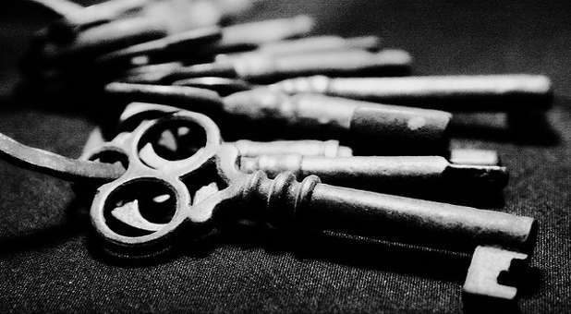
Compare Matthew 16:19 with Isaiah 22:15-22
¹⁹ I will give you the keys of the kingdom of heaven, and whatever you bind on earth shall be bound in heaven, and whatever you loose on earth shall be loosed in heaven.”
²² And I will place on his shoulder the key of the house of David; he shall open, and none shall shut; and he shall shut, and none shall open.”

Slide 34
John 21:15-17
¹⁵ When they had finished breakfast, Jesus said to Simon Peter, “Simon, son of John, do you love me more than these?”
He said to him, “Yes, Lord; you know that I love you.”
He said to him, “Feed my lambs.”
¹⁶ A second time he said to him, “Simon, son of John, do you love me?”
He said to him, “Yes, Lord; you know that I love you.”
He said to him, “Tend my sheep.” ¹⁷
He said to him the third time, “Simon, son of John, do you love me?”
Peter was grieved because he said to him the third time, “Do you love me?” And he said to him, “Lord, you know everything; you know that I love you.”
Jesus said to him, “Feed my sheep.

Slide 36
John 21:15-17
¹⁵ When they had finished breakfast, Jesus said to Simon Peter, “Simon, son of John, do you love me more than these?”
He said to him, “Yes, Lord; you know that I love you.”
He said to him, “Feed my lambs.”

Slide 37
John 21:15-17
¹⁶ A second time he said to him, “Simon, son of John, do you love me?”
He said to him, “Yes, Lord; you know that I love you.”
He said to him, “Tend my sheep.” ¹⁷

Slide 38
John 21:15-17
He said to him the third time, “Simon, son of John, do you love me?”
Peter was grieved because he said to him the third time, “Do you love me?” And he said to him, “Lord, you know everything; you know that I love you.”
Jesus said to him, “Feed my sheep.

Slide 39
John 21:15-17
¹⁵ When they had finished breakfast, Jesus said to Simon Peter, “Simon, son of John, do you love me more than these?”
He said to him, “Yes, Lord; you know that I love you.”
He said to him, “Feed my lambs.”
¹⁶ A second time he said to him, “Simon, son of John, do you love me?”
He said to him, “Yes, Lord; you know that I love you.”
He said to him, “Tend my sheep.” ¹⁷
He said to him the third time, “Simon, son of John, do you love me?”
Peter was grieved because he said to him the third time, “Do you love me?” And he said to him, “Lord, you know everything; you know that I love you.”
Jesus said to him, “Feed my sheep.

Slide 40
https://www.instagram.com/p/BsiqXI7ANcT/?utm_source=ig_web_copy_link

Slide 41
III. The Hierarchy of the Catholic Church
The Episcopal College and its head, the Pope
When Christ instituted the Twelve Apostles, He constituted them in the form of a college or permanent assembly, at the head of which He placed Peter, chosen from among them.”
Further Proof Texts from the Bible:
Matthew 10:2-4,Mark 3:16-19,Luke 6:14-16,Acts 1:13

Slide 42
III. The Hierarchy of the Catholic Church
…at the head of which He placed Peter
Further Proof Texts from the Bible:
Matthew 10:2-4,Mark 3:16-19,Luke 6:14-16,Acts 1:13
What do these texts have in common?

Slide 43
III. The Hierarchy of the Catholic Church
…at the head of which He placed Peter
Further Proof Texts from the Bible:
Matthew 10:2-4,Mark 3:16-19,Luke 6:14-16,Acts 1:13
What do these texts have in common?
In every list of the Apostles in the Bible, Peter is always mentioned first.

Slide 44
III. The Hierarchy of the Catholic Church
…at the head of which He placed Peter
Further Proof Texts from the Bible:
Luke 9:32, sometimes the apostles were referred to as "Peter and those who were with him”
Matt. 18:21, Mark 8:29, Luke 12:41, John 6:68-69 Peter was the one who generally spoke for the apostles,
Matt. 14:28-32, Matt. 17:24-27, Mark 10:23-28 and he figured in many of the most dramatic scenes
Acts 2:14-40 On Pentecost it was Peter who first preached to the crowds
Acts 3:6-7 and he worked the first healing in the Church age
Luke 22:32 It is Peter’s faith that will strengthen his brethren
John 21:17 Peter is given Christ’s flock to shepherd
Mark 16:7 An angel was sent to announce the resurrection to Peter
Luke 24:34 the risen Christ first appeared to Peter
Acts 1:13-26 He headed the meeting that elected Matthias to replace Judas
Acts 2:41 he received the first converts
Acts 5:1-11 He inflicted the first punishment
Acts 8:18-23 excommunicated the first heretic
Acts 15 He led the first council in Jerusalem
Acts 15:7-11 announced the first dogmatic decision
Acts 10:46-48 It was to Peter that the revelation came that Gentiles were to be baptized and accepted as Christiansn

Slide 45
III. The Hierarchy of the Catholic Church
…at the head of which He placed Peter
Further Proof Texts from the Bible:
Luke 9:32, sometimes the apostles were referred to as "Peter and those who were with him”
Matt. 18:21, Mark 8:29, Luke 12:41, John 6:68-69 Peter was the one who generally spoke for the apostles,
Matt. 14:28-32, Matt. 17:24-27, Mark 10:23-28 and he figured in many of the most dramatic scenes
Acts 2:14-40 On Pentecost it was Peter who first preached to the crowds
Acts 3:6-7 and he worked the first healing in the Church age
Luke 22:32 It is Peter’s faith that will strengthen his brethren
John 21:17 Peter is given Christ’s flock to shepherd
Mark 16:7 An angel was sent to announce the resurrection to Peter
Luke 24:34 the risen Christ first appeared to Peter
Acts 1:13-26 He headed the meeting that elected Matthias to replace Judas
Acts 2:41 he received the first converts
Acts 5:1-11 He inflicted the first punishment
Acts 8:18-23 excommunicated the first heretic
Acts 15 He led the first council in Jerusalem
Acts 15:7-11 announced the first dogmatic decision
Acts 10:46-48 It was to Peter that the revelation came that Gentiles were to be baptized and accepted as Christians

Slide 46
III. The Hierarchy of the Catholic Church
The Episcopal College and its head, the Pope
When Christ instituted the Twelve Apostles, He constituted them in the form of a college or permanent assembly, at the head of which He placed Peter, chosen from among them."
Just as by the Lord's institution, St. Peter and the rest of the apostles constitute a single apostolic college, so in like fashion the Pope - Peter's successor, and the bishops - the successors of the apostles, are the Episcopal College.

Slide 47
III. The Hierarchy of the Catholic Church
The Episcopal College and its head, the Pope
The Lord made Simon alone, whom he named Peter, the "rock" of his Church.
He gave him the keys of his Church and
instituted him shepherd of the whole flock.
"The office of binding and loosing which was given to Peter was also assigned to the college of apostles united to its head.”
This pastoral office of Peter and the other apostles belongs to the Church's very foundation and is continued by the bishops under the primacy of the Pope.

Slide 48
III. The Hierarchy of the Catholic Church
The Episcopal College and its head, the Pope
The Pope, Bishop of Rome and Peter's successor, "is the perpetual and visible source and foundation of the unity both of the bishops and of the whole company of the faithful.”

Slide 49
III. The Hierarchy of the Catholic Church
The Episcopal College and its head, the Pope
The Pope, Bishop of Rome and Peter's successor, "is the perpetual and visible source and foundation of the unity both of the bishops and of the whole company of the faithful.”
"For the Roman Pontiff, by reason of his office as Vicar of Christ, and as pastor of the entire Church has full, supreme, and universal power over the whole Church, a power which he can always exercise unhindered.”

Slide 50
III. The Hierarchy of the Catholic Church
The Episcopal College and its head, the Pope
The Pope, Bishop of Rome and Peter's successor, "is the perpetual and visible source and foundation of the unity both of the bishops and of the whole company of the faithful.”
"For the Roman Pontiff, by reason of his office as Vicar of Christ, and as pastor of the entire Church has full, supreme, and universal power over the whole Church, a power which he can always exercise unhindered.”
"The college or body of bishops has no authority unless united with the Roman Pontiff, Peter's successor, as its head.”

Slide 51
III. The Hierarchy of the Catholic Church
The Episcopal College and its head, the Pope
The Pope, Bishop of Rome and Peter's successor, "is the perpetual and visible source and foundation of the unity both of the bishops and of the whole company of the faithful.”
"For the Roman Pontiff, by reason of his office as Vicar of Christ, and as pastor of the entire Church has full, supreme, and universal power over the whole Church, a power which he can always exercise unhindered.”
"The college or body of bishops has no authority unless united with the Roman Pontiff, Peter's successor, as its head."
"The college of bishops exercises power over the universal Church in a solemn manner in an ecumenical council.”

Slide 52
III. The Hierarchy of the Catholic Church
The Episcopal College and its head, the Pope
The Teaching Office The Magisterium

Slide 53
III. The Hierarchy of the Catholic Church
The Episcopal College and its head, the Pope
The Teaching Office The Magisterium
Bishops, with priests as co-workers, have as their first task "to preach the Gospel of God to all men," in keeping with the Lord's command.

Slide 54
III. The Hierarchy of the Catholic Church
The Episcopal College and its head, the Pope
The Teaching Office The Magisterium
Bishops, with priests as co-workers, have as their first task "to preach the Gospel of God to all men," in keeping with the Lord's command.
The duty of the Magisterium is aimed at seeing to it that the People of God abides in the truth that liberates.

Slide 55
III. The Hierarchy of the Catholic Church
The Episcopal College and its head, the Pope
The Teaching Office The Magisterium
Bishops, with priests as co-workers, have as their first task "to preach the Gospel of God to all men," in keeping with the Lord's command.
The duty of the Magisterium is aimed at seeing to it that the People of God abides in the truth that liberates. To fulfill this service, Christ endowed the Church's shepherds with the charism of infallibility in matters of faith and morals.

Slide 56
III. The Hierarchy of the Catholic Church
The Episcopal College and its head, the Pope
The Teaching Office The Magisterium
"The task of giving an authentic interpretation of the Word of God, whether in its written form or in the form of Tradition, has been entrusted to the living teaching office of the Church alone.
Its authority in this matter is exercised in the name of Jesus Christ.”
This means that the task of interpretation has been entrusted to the bishops in communion with the successor of Peter, the Bishop of Rome.

Slide 57
III. The Hierarchy of the Catholic Church
The Episcopal College and its head, the Pope
The Teaching Office The Magisterium
Luke 10:16
“He who hears you hears me, and he who rejects you rejects me, and he who rejects me rejects him who sent me.”

Slide 58
III. The Hierarchy of the Catholic Church
The Episcopal College and its head, the Pope
The Teaching Office The Magisterium
The Church's Magisterium exercises the authority it holds from Christ when it defines dogmas
Dogma of the faith a Truth which must be believed and adhered to by the faithful

Slide 59
III. The Hierarchy of the Catholic Church
The Episcopal College and its head, the Pope
The Teaching Office The Magisterium
The Church's Magisterium exercises the authority it holds from Christ when it defines dogmas
Dogma of the faith a Truth

Slide 60
III. The Hierarchy of the Catholic Church
The Episcopal College and its head, the Pope
The Teaching Office The Magisterium
The Church's Magisterium exercises the authority it holds from Christ when it defines dogmas
Dogma of the faith a Truth which must be believed

Slide 61
III. The Hierarchy of the Catholic Church
The Episcopal College and its head, the Pope
The Teaching Office The Magisterium
The Church's Magisterium exercises the authority it holds from Christ when it defines dogmas
Dogma of the faith a Truth which must be believed and adhered to by the faithful

Slide 62
III. The Hierarchy of the Catholic Church
The Episcopal College and its head, the Pope
The Teaching Office The Magisterium
The Church's Magisterium exercises the authority it holds from Christ when it defines dogmas
Dogma of the faith a Truth which must be believed and adhered to by the faithful
Truths which is of divine Revelation
A mortal sin not to adhere to as a binding matter of faith and morals.

Slide 63
III. The Hierarchy of the Catholic Church
The Episcopal College and its head, the Pope
The Teaching Office The Magisterium
The Church's Magisterium exercises the authority it holds from Christ when it defines dogmas
Dogma of the faith a Truth which must be believed and adhered to by the faithful
Truths which is of divine Revelation
A mortal sin not to adhere to as a binding matter of faith and morals.
An example of a dogma of the faith is the Catholic beliefs of the Eucharist

Slide 64
III. The Hierarchy of the Catholic Church
An example of a dogma of the faith is the Catholic beliefs of the Eucharist
What do we believe?

Slide 65
III. The Hierarchy of the Catholic Church
An example of a dogma of the faith is the Catholic beliefs of the Eucharist
What do we believe?
The Eucharist is the source and summit of the Christian life.

Slide 66
III. The Hierarchy of the Catholic Church
An example of a dogma of the faith is the Catholic beliefs of the Eucharist
What do we believe?
The Eucharist is the source and summit of the Christian life.
Jesus is literally and wholly present—body and blood, soul and divinity—under the appearances of bread and wine.

Slide 67
III. The Hierarchy of the Catholic Church
An example of a dogma of the faith is the Catholic beliefs of the Eucharist
What do we believe?
The Eucharist is the source and summit of the Christian life.
All other things are bound up with the Eucharist and are oriented toward it. For in the blessed Eucharist is contained the whole spiritual good of the Church, namely Christ himself

Slide 68
The Apostles' Creed
I believe in God, the Father almighty, Creator of heaven and earth, and in Jesus Christ, His only Son, our Lord, Who was conceived by the Holy Spirit, born of the Virgin Mary, suffered under Pontius Pilate, was crucified, died and was buried; He descended into hell; on the third day He rose again from the dead; He ascended into heaven, and is seated at the right hand of God the Father almighty; from there He will come to judge the living and the dead. I believe in the Holy Spirit, the holy catholic Church, the communion of saints, the forgiveness of sins, the resurrection of the body, and life everlasting. Amen.

Slide 69
The Nicene Creed
I believe in one God, the Father almighty, maker of heaven and earth, of all things visible and invisible.
I believe in one Lord Jesus Christ, the Only Begotten Son of God, born of the Father before all ages. God from God, Light from Light, true God from true God, begotten, not made, consubstantial with the Father; through Him all things were made. For us men and for our salvation He came down from heaven, and by the Holy Spirit was incarnate of the Virgin Mary, and became man. For our sake He was crucified under Pontius Pilate, He suffered death and was buried, and rose again on the third day in accordance with the Scriptures. He ascended into heaven and is seated at the right hand of the Father. He will come again in glory to judge the living and the dead and His kingdom will have no end.
I believe in the Holy Spirit, the Lord, the giver of life, Who proceeds from the Father and the Son, Who with the Father and the Son is adored and glorified, Who has spoken through the prophets.
I believe in one, holy, catholic and apostolic Church. I confess one Baptism for the forgiveness of sins and I look forward to the resurrection of the dead and the life of the world to come. Amen.

Slide 70
Comparing the Apostles' Creed with the Nicene Creed
Apostle’s Creed
I believe in God, the Father almighty, Creator of heaven and earth,
and in Jesus Christ, his only Son, our Lord,
Who was conceived by the Holy Spirit,
born of the Virgin Mary,
Nicene Creed
I believe in one God, the Father almighty, maker of heaven and earth, of all things visible and invisible.
I believe in one Lord Jesus Christ, the Only Begotten Son of God, born of the Father before all ages. God from God, Light from Light, true God from true God, begotten, not made, consubstantial with the Father; through Him all things were made. For us men and for our salvation He came down from heaven,
and by the Holy Spirit was incarnate of the Virgin Mary, and became man.

Slide 71
Comparing the Apostles' Creed with the Nicene Creed
Apostle’s Creed
suffered under Pontius Pilate, was crucified, died and was buried; He descended into hell;
on the third day He rose again from the dead;
He ascended into heaven, and is seated at the right hand of God the Father almighty;
from there He will come to judge the living and the dead
Nicene Creed
For our sake He was crucified under Pontius Pilate, He suffered death and was buried,
and rose again on the third day
in accordance with the Scriptures.
He ascended into heaven and is seated at the right hand of the Father.
He will come again in glory to judge the living and the dead
And His kingdom will have no end.

Slide 72
Comparing the Apostles' Creed with the Nicene Creed
Apostle’s Creed
I believe in the Holy Spirit,
the holy catholic Church,
the communion of saints,
the forgiveness of sins,
the resurrection of the body, and life everlasting.
Amen.
Nicene Creed
I believe in the Holy Spirit, the Lord, the giver of life,
Who proceeds from the Father and the Son,
Who with the Father and the Son is adored and glorified,
Who has spoken through the prophets.
I believe in one, holy, catholic and apostolic Church.
I confess one Baptism for the forgiveness of sins
and I look forward to the resurrection of the dead and the life of the world to come.
Amen.

